Slide 1
Merge vs Append
Merge vs Append

Slide 2
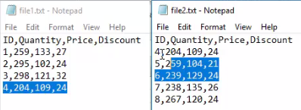
Merge vs Append
Note: This lab uses the files File1.txt and File2.txt located in the resources \Multiple Files\Files folder
Search for the files File1.txt and File2.txt in the query editor.
Check if both files have the same data structure.
Notice that there is one line in common between the two files.

Slide 3
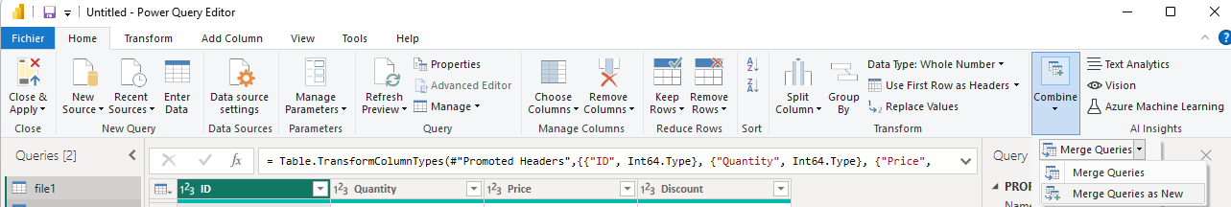
Merge vs Append
Select "Merge queries as new" from the Combine option in the Home tab .

Slide 4
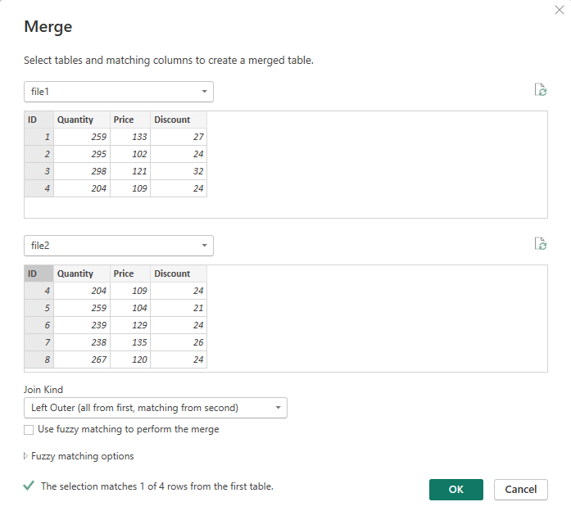
Merge vs Append
Select the ID columns of both files and notice that the OK button becomes active.

Slide 5
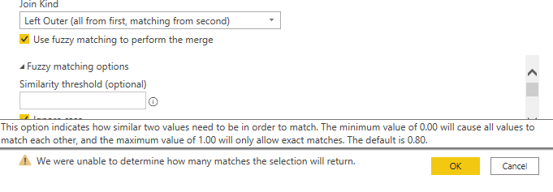
Merge vs Append
Test this example with all possible join types.
Observe the fuzzy matching option ( Fuzzy Matching ) , used when the common values are not strictly identical but similar.
Note that the similarity degree ranges from 0 to 1, with a default value of 0.8.
Repeat the same exercise with "Append as New" and observe the difference in the result.

Slide 6
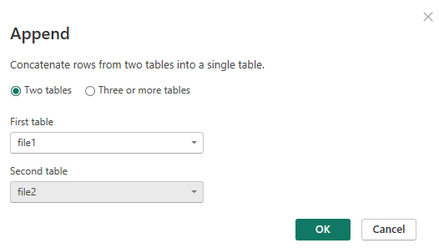
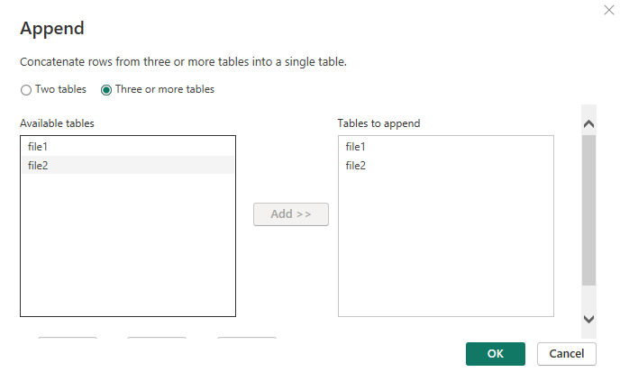
Merge vs Append
Redo the exercise with append as an option this time.

Slide 7
Thank you
Thank you

